Slide 1

Yug Karande Roll-36 7-C
This Photo by Unknown Author is licensed under CC BY-SA

Slide 2
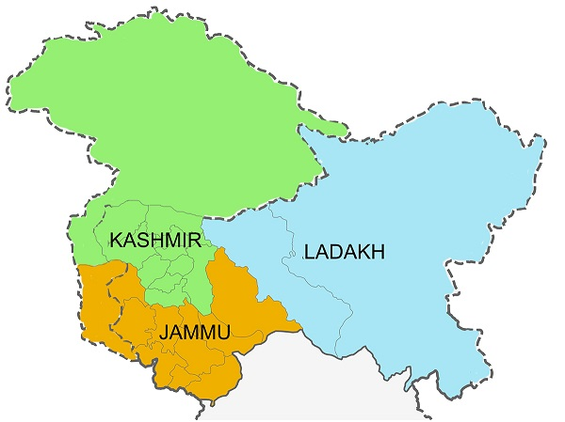
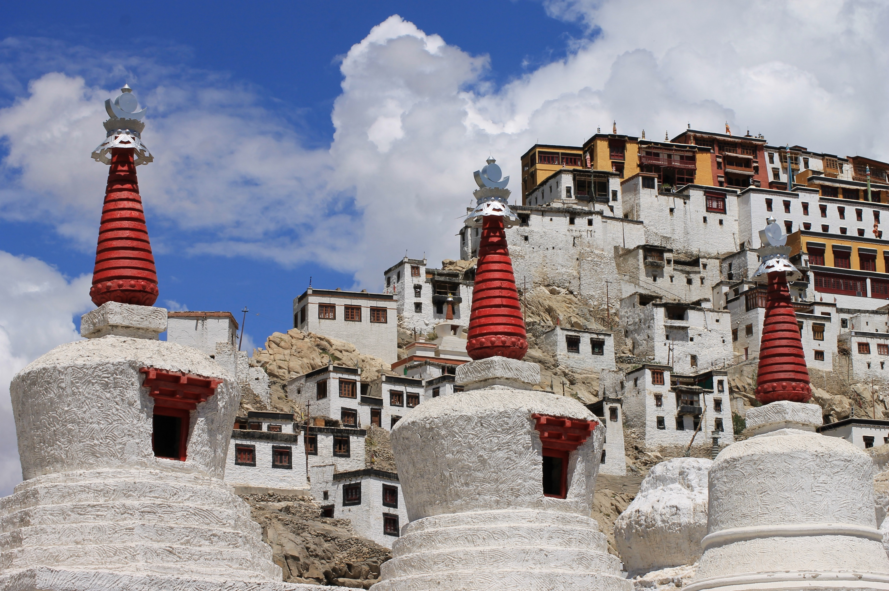
Thicksey monastery

Slide 3

Getting Deep 1 ) Place to stay – Karakoram Hotel 2 )Cost of hotel – Rs 4256 3 )Things to bring – Ladakh is called as cold dessert so it is cold over there so I would advise to take pair of sweaters, thermal cloths, and shawls , etc. 4 )Transport – The b est mean of transport would be airways so the nearest airport is Kushok Bakula Rimpochee Airport

Slide 4
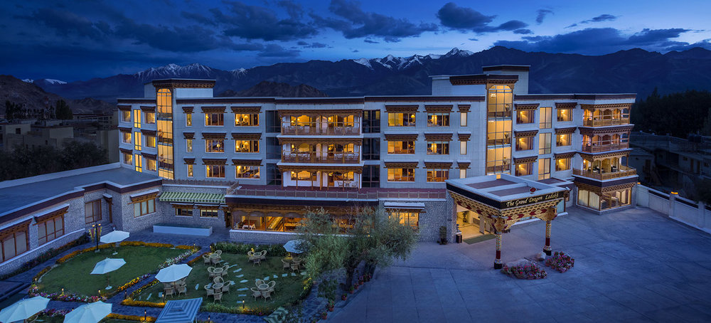
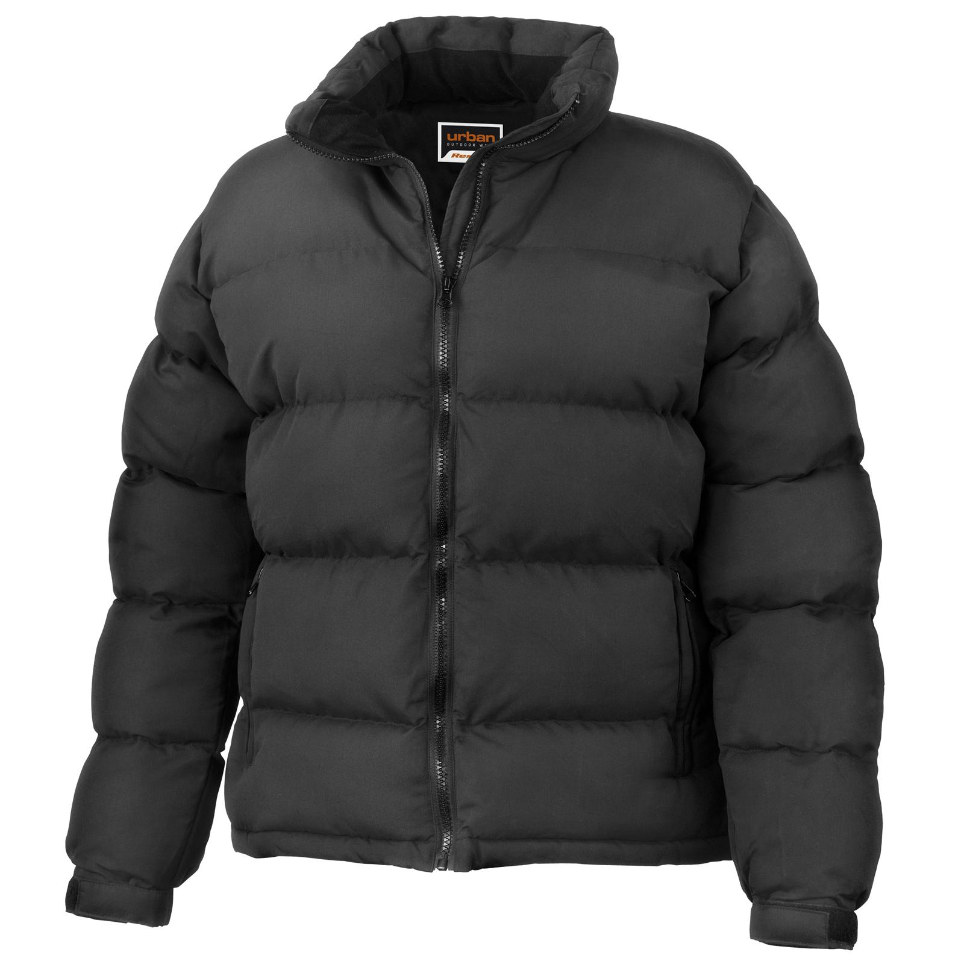
PICTURES
This Photo by Unknown Author is licensed under CC BY-NC

Slide 5


